Slide 1
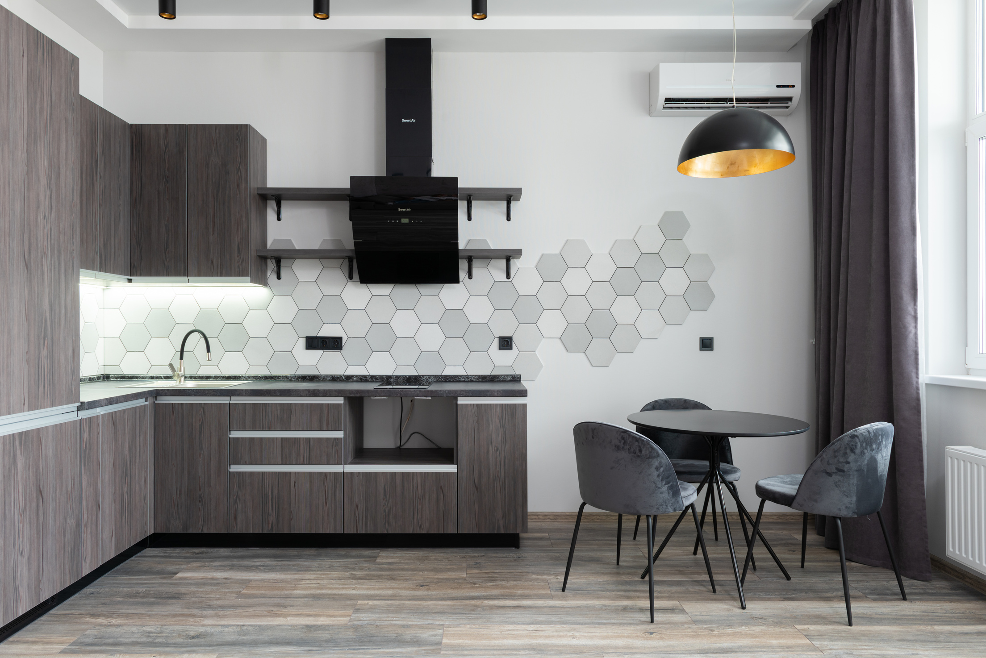

HOME AUTOMATION
THOMAS A (URK22CO2021)
VEYILU MUTHU S (URK22CO3006)
MITHUN (URK22CS7001)
PRANESH KUMAR (URK22CS5084)

Slide 2

CONTENTS
INTRODUCTION
OBJECTIVES
PROBLEM STATEMENT
PURPOSE
HARDWARE COMPONENTS
SOFTWARE COMPONENTS
METHODOLOGY
BLOCK DIAGRAM
PROJECT OUTPUT
WORKING OUTPUT

Slide 3

01
Home automation is also known as "smart home technology."
02
It allows you to control, monitor, and optimize your home through connected devices and intelligent systems.
03
We'll explore how it makes life more convenient, efficient, and secure.
INTRODUCTION

Slide 4
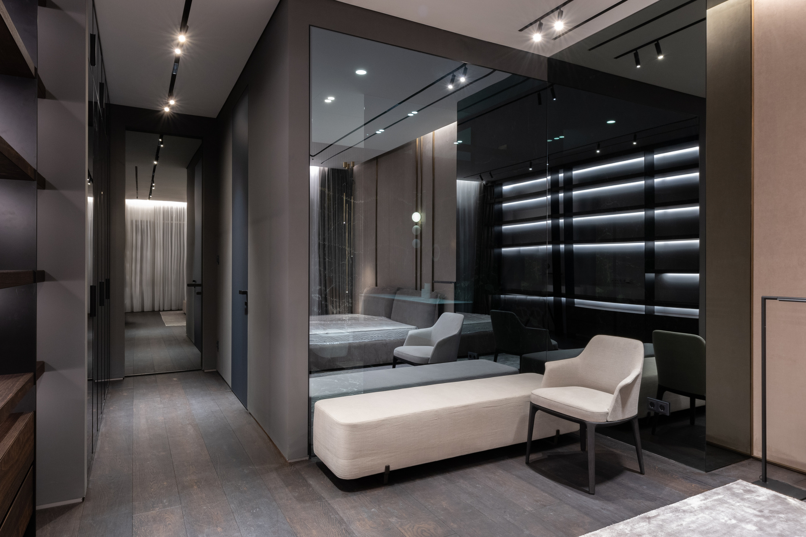

Energy efficiency
User friendly
Seamless Integration
Secure and safe
Virtual Reality HomeControl
OBJECTIVES

Slide 5
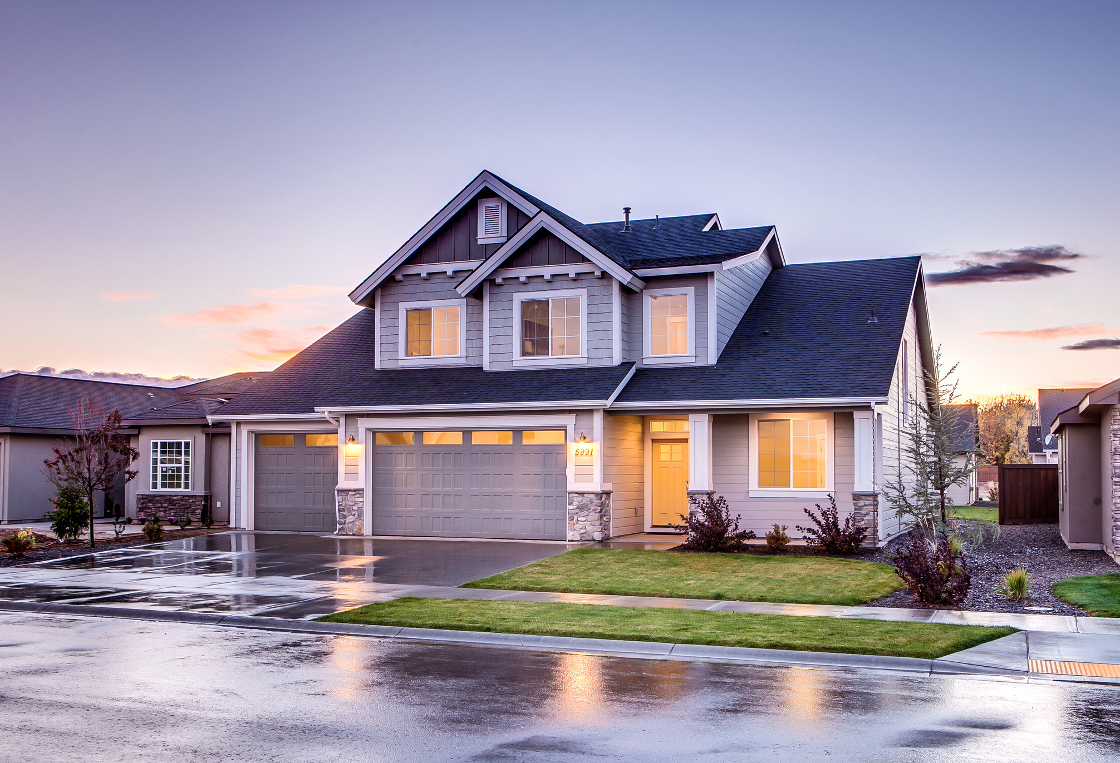
PROBLEM STATEMENT
Existing home environments lackefficient control systems, resultingin energy wastage and inadequatesecurity measures.
This project aims to develop smarthome system integrating devicecontrol, voice assistance, energyoptimization, and enhanced securityto simplify users' daily lives

Slide 6
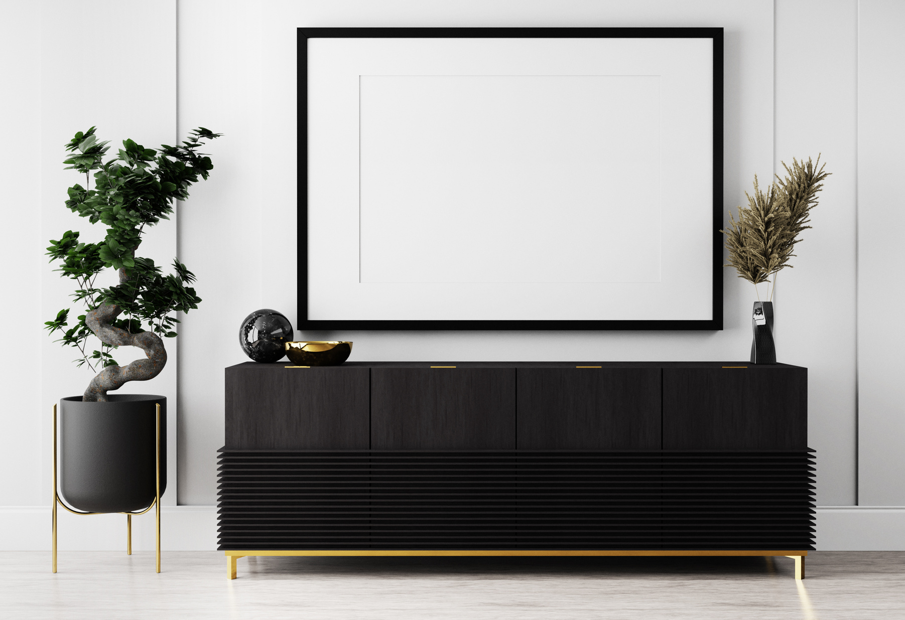
PURPOSE
Our project's purpose is to transform home living by creating a smart home automation system that optimizes energy use, ensures user-friendly control, seamless integration, and advanced security. We aim to simplify daily life, enhance energy efficiency, and guarantee user safety and comfort, showcasing our commitment to innovation, sustainability, and secure living

Slide 7
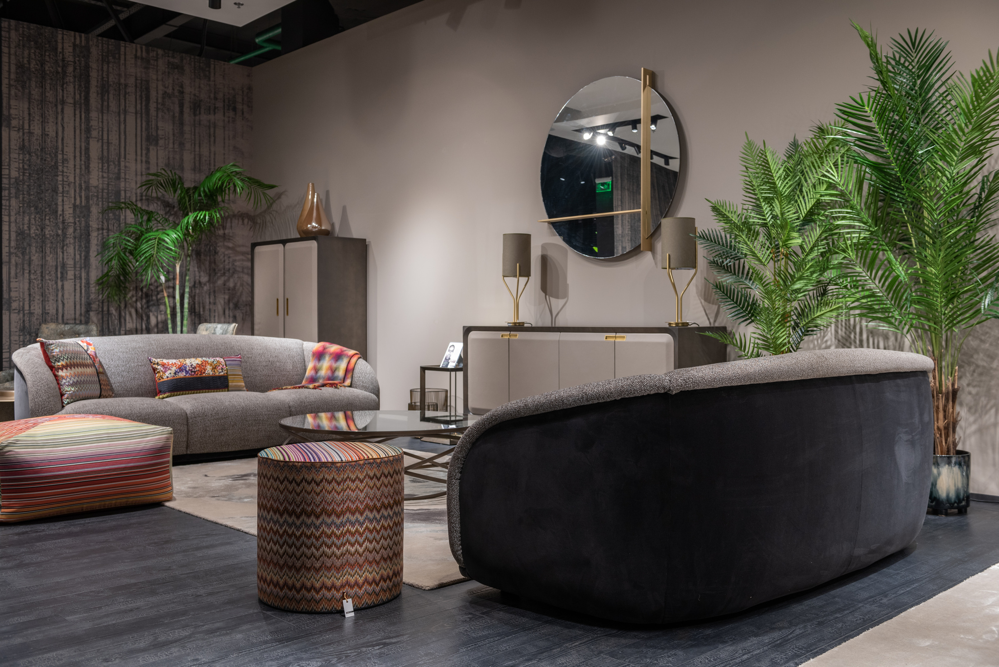


NodeMCU
4-channel 5V SPDT RelayModule
Manual Switches orPushbuttons
Led Bulbs
Breadboard,wires
Bulb Holder
HARDWARE COMPONENTS

Slide 8

SOFTWARE COMPONENTS
Arduino IDE
Blynk
Sinric pro
Google assistant or alexa

Slide 9

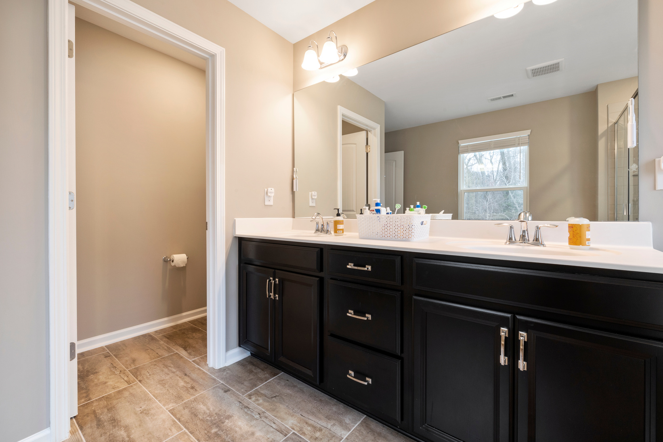
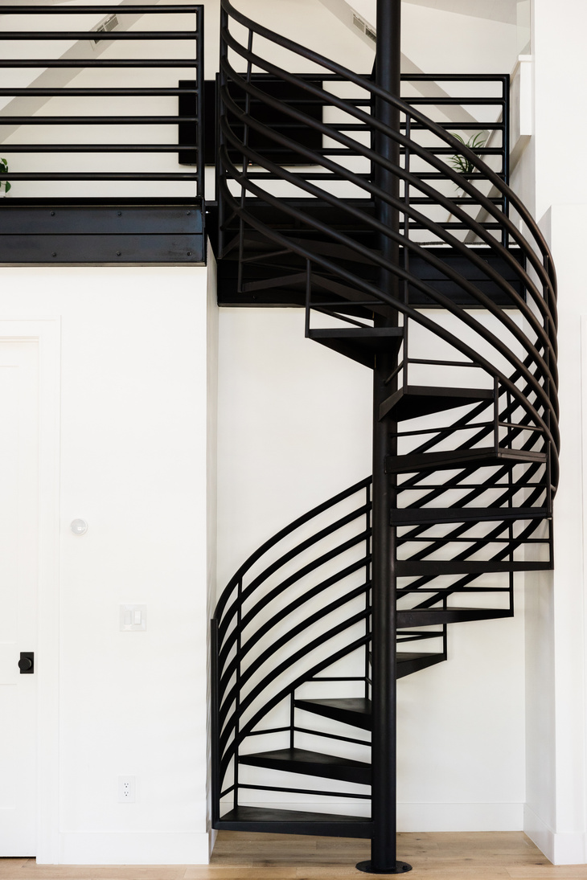
METHODOLOGY
Our smart home automation approach starts with system configuration, hardware integration (NodeMCU, relay modules), and software configuration (Arduino IDE, Blynk, Sinric Pro, voice assistant).
The development phase includes NodeMCU configuration and voice management for the mobile app with a focus on energy efficiency and security. Rigorous testing ensures reliability, followed by practical and practical training. Ongoing inspection and maintenance assures long service life. Complete characters support future expansion.

Slide 10
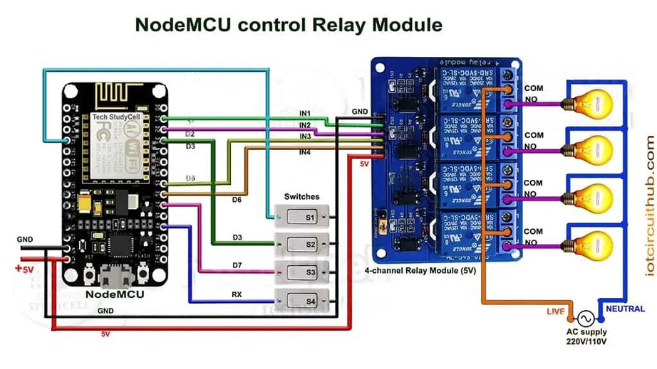
BLOCK DIAGRAM

Slide 11
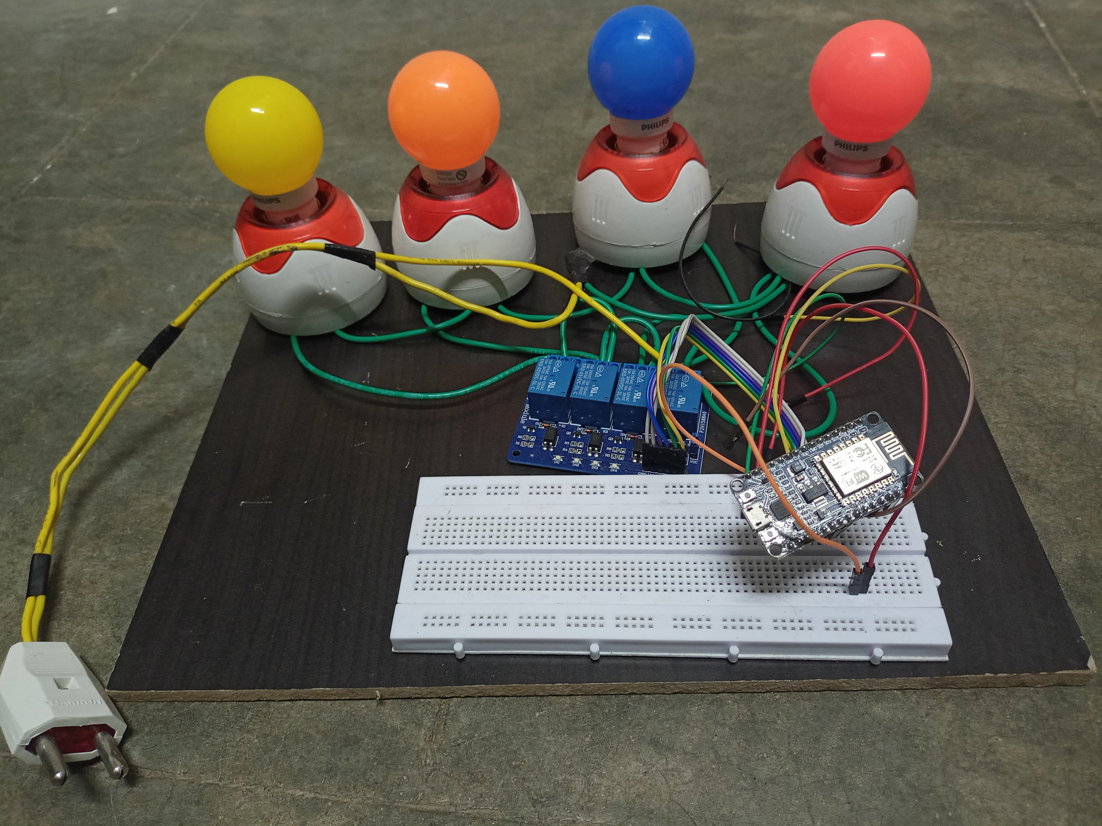
PROJECT OUTPUT

Slide 12
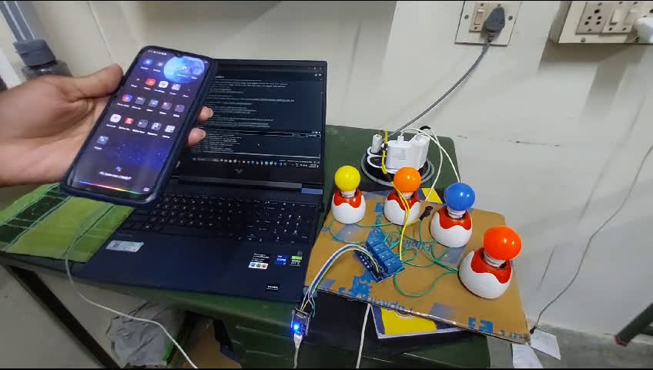
WORKING MODEL

Slide 13

THANK YOU
hello@reallygreatsite.com
reallygreatsite.com
123-456-7890

